Slide 1

Ad-hoc On-Demand Distance Vector Protocol (AODV)
Course title:
Wireless & Mobile Networks
Professor:
Dr. Zeinab MOVAHEDI

Slide 2
AODV Concept
Reactive (on-demand) routing protocol
Path discovery initialized when a new route is needed
Nodes not on active paths don’t maintain routing information
Based on bi-directional links
A broadcast route discovery mechanism
Based on Route Request (RREQ) and Route Reply (RREP) packets
Dynamic establishment & record of route table entries
A routing table entry is expired if not used recently
Update routing table through destination sequence#
Prevention of routing loops
Avoidance of old and broken routes

Slide 3
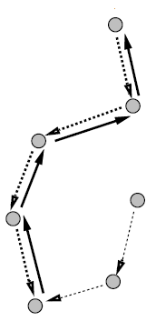
Path Discovery Mechanism Broadcasting RREQ
Initiated by broadcasting a Route Request (RREQ)
< broadcast_id, src_addr, src_seq, dest_addr, dest_seq#, hop_cnt>
broadcast_id incremented when the source sends a new RREQ
The path discovery is initiated when a source needs to communicate with a destination for which it has no route in its table.
To uniquely identify a RREQ
Freshness of the forward path to the destination, last known # to the source
Freshness of the reverse route to the source
S
D

Slide 4
Path Discovery Mechanism Receiving RREQ at intermediate node
If duplicate, drops the RREQ
Else
If no active route, rebroadcasts the RREQ increasing its hop_cnt
Otherwise, it sends a Route Reply (RREP) back to source
Anyway, keeps track of information required for
identifying the recived RREQ: <src_addr, broadcast_id>
setting up reverse path: <src_addr, src_seq#, hop_cnt, expiration timer>
Nodes not along the path determined by the RREP will timeout after ACTIVE_ROUTE_TIMEOUT

Slide 5
Path Discovery Mechanism Reverse path setup
Automatically maintained by intermediate node
A pointer to the neighbor from which it received the first copy of RREQ
Valid during ACTIVE_ROUTE_TIMEOUT
An enough time for RREQ to traverse the network and produce a RREP back to the source
S
D

Slide 6
Path Discovery Mechanism Receiving RREQ at intermediate node with route entry
Checks if RREQ received over bi-directional link
Check if the route is current
dest_seq# in RREQ < dest_seq# in route entry
No, Rebrodcast RREQ
Yes, sends RREP back to source
<src_addr, dest_addr, dest_seq#, hop_cnt, lifetime>

Slide 7
Path Discovery Mechanism Receiving RREP along the reverse path
If
(the first RREP received) OR
(RREP dest_seq# > route entry dest_seq#) OR
(RREP dest_seq# = route entry dest_seq#) & (RREP hop_cnt < route entry hop_cnt)
Yes,
set the forward path pointing to the node from which the RREP comes
update the ACTIVE_ROUTE_TIMEOUT for reverse and forward path
records the latest dest_seq# for destination
No, ignore RREP

Slide 8
Path Discovery Mechanism Receiving RREP at source
The source node receiving RREP,
Begins immediately its data transmission
may later update its route entry based on a new RREP

Slide 9
AODV Example
A
L
Y
F
J
B
K
D
G
P
S
C
E
H
I
T
RREQ
Z

Slide 10
AODV Example
A
L
Y
F
J
B
K
D
G
P
S
C
E
H
I
T
Reverse Path Setup
Z

Slide 11
AODV Example
A
L
Y
F
J
B
K
D
G
P
S
C
E
H
I
T
Z

Slide 12
AODV Example
A
L
Y
F
J
B
K
D
G
P
S
C
E
H
I
T
Z

Slide 13
AODV Example
A
L
Y
F
J
B
K
D
G
P
S
C
E
H
I
T
Z
RREP

Slide 14
AODV Example
A
L
Y
F
J
B
K
D
G
P
S
C
E
H
Forward path setup
I
T
Z

Slide 15
AODV Example
A
L
Y
F
J
B
K
D
G
P
S
C
E
H
I
T
Z

Slide 16
AODV Example
A
L
Y
F
J
B
K
D
G
P
S
C
E
H
I
T
Z

Slide 17
AODV Example
A
L
Y
F
J
B
K
D
G
P
S
C
E
H
I
T
Z

Slide 18
Route table management
Soft-states associated with each entry
RREQ expiration timer for reverse path routing entries
purge related from nodes not lying on the path from source to destination
depends to the size of MANET
Route caching timeout
time after which route considered invalid
is postponed by active_route_timeout each time entry used for a transmission
List of active neighbors for that destination
neighbors originating/relaying at least one packet for that destination within active-timeout period
to notify all active sources when a link along the path to a given destination breaks
a route entry is active if it is in use by any active neighbors

Slide 19
Route table management
Destination | Next hop | Number of hops | Destination Seq # | Active neighbors for this route | Expiration time
The route entry is updated upon reception of a new RREP for a destination, only if
the destination seq# in RREP is greater than the one in table
if equal but the hop count in RREP smaller than the number of hops in table

Slide 20
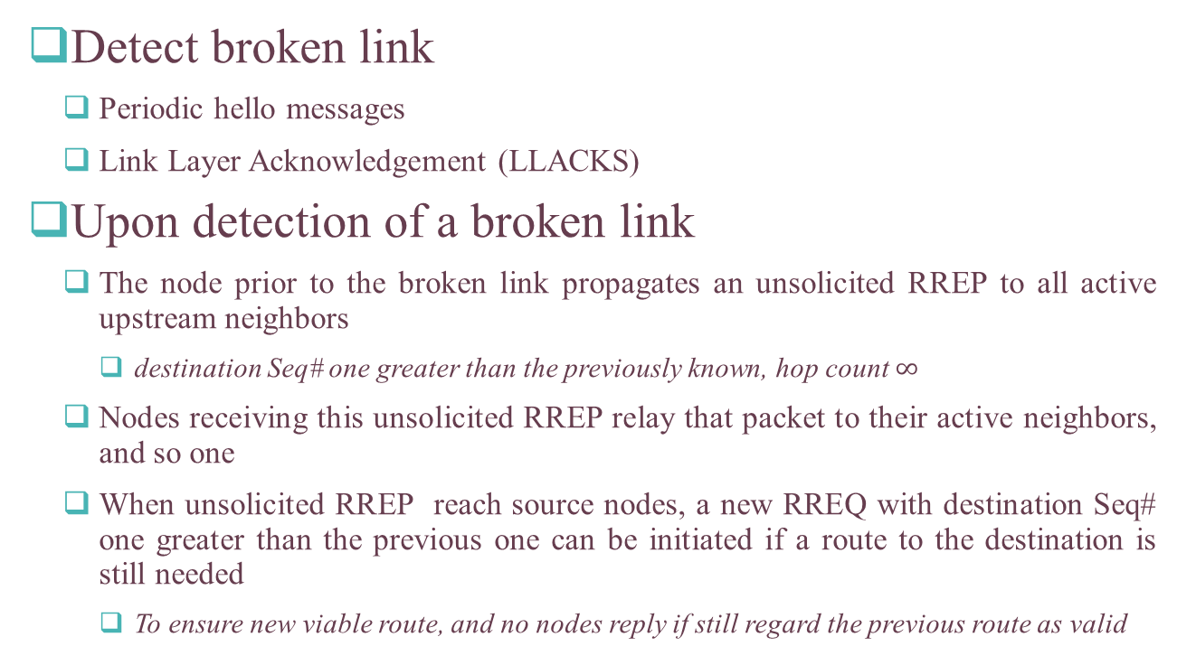
Route maintenance
Detect broken link
Periodic hello messages
Link Layer Acknowledgement (LLACKS)
Upon detection of a broken link
The node prior to the broken link propagates an unsolicited RREP to all active upstream neighbors
destination Seq# one greater than the previously known, hop count $∞$
Nodes receiving this unsolicited RREP relay that packet to their active neighbors, and so one
When unsolicited RREP reach source nodes, a new RREQ with destination Seq# one greater than the previous one can be initiated if a route to the destination is still needed
To ensure new viable route, and no nodes reply if still regard the previous route as valid

Slide 21
Local connectivity management
When receiving a broadcast packet from a neighbor
A node broadcasts locally a hello message (special unsolicited RREP) with its sequence number if does not send any packets to all of its active upstream neighbors within hello_interval
Local connectivity change
Receving hello or broadcast packet from a new neighbor
Failing to receive allowed_hello_loss consecutive hello message from an active neighbor
Hello messages are used also to ensure bidirectional connectivity
Need to be specifically configured to save bandwidth

